Slide 1
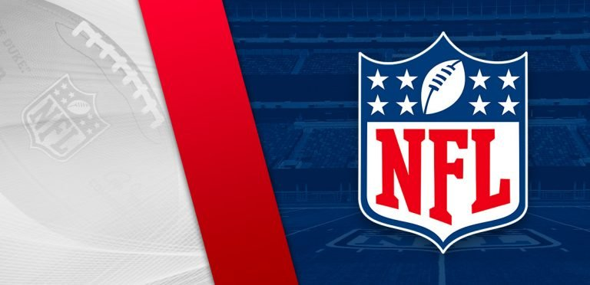
Classifying Pass-types in NFL using Statistical Learning Methods
Presented by :
Rahul Kamal Pandey
Kruthika Madhusudhana
Sharath Tamvada

Slide 2

Motivation
This project is inspired from the state of the art technologies like NFL Next Gen Stats that were invested in National Football League data exploration. The NFL big data bowl was an initiative taken in pursuit of advancing data and sports analytics. Prior to these technologies, keeping track of real time data had not been possible. But with more and more new inventions, radical techniques in finding new and creative was to collect data in real time from the field has made machine learning applicable in sports. Idealistically, there is immense scope in improving performances of real time updates and insights from this data so managers can make decisions that shape the team over the course of the season.

Slide 3
Problem Statement
Coverage schemes, quarterback positioning, and team orientations are some of the critical decision making aspects that managers in the NFL have long explored. The NFL big data bowl this year aims to use data analytics to better understand the schemes and players that make for a successful defense against passing plays. With the Data at hand, this project aims to utilize predictive analysis to infer the effectiveness of an offensive team’s play by classifying the type of pass and determine a successful pass over an incomplete pass.

Slide 4
Data Description
The 2021 Big Data Bowl contains player tracking, play, game, and player level information for all possible passing plays during the 2018 regular season
Also, there are 17 weeks to a standard NFL Regular season and each of these week’s files of tracking data contains the player tracking data from all passing plays
Game Data : Team playing in each game
Player Data : Player level Information of all players participated in tracking data
Play Data : Play-level Information for each game
Tracking Data : Player Tracking Data for all games in the weeks
Key variables: gameId, nflId, playId

Slide 5
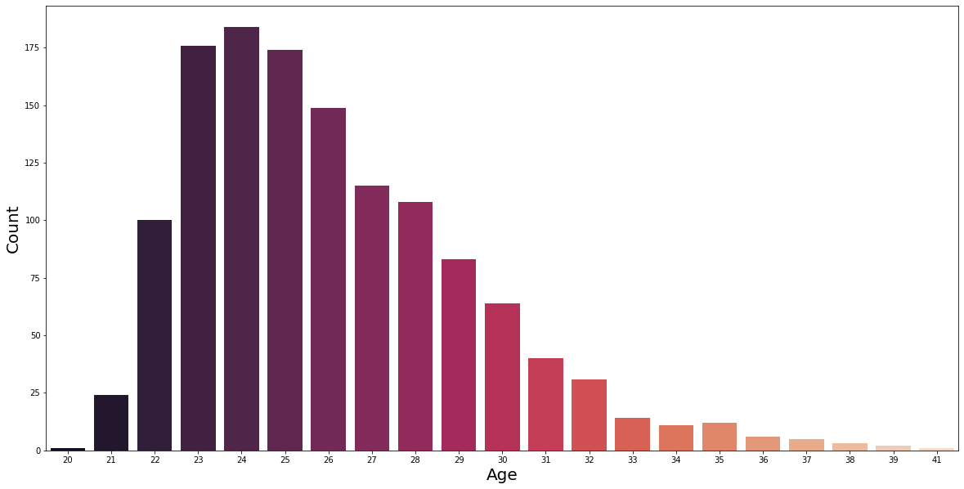
Exploratory Data Analysis

Slide 6
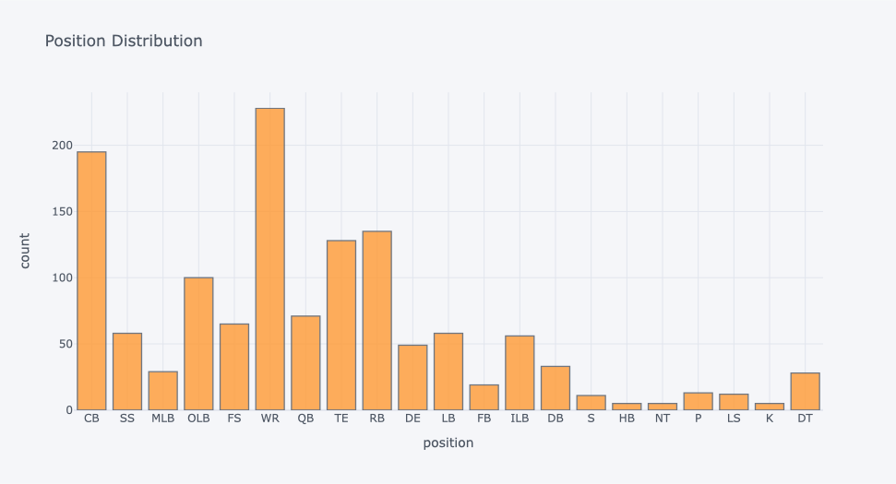
Exploratory Data Analysis

Slide 7
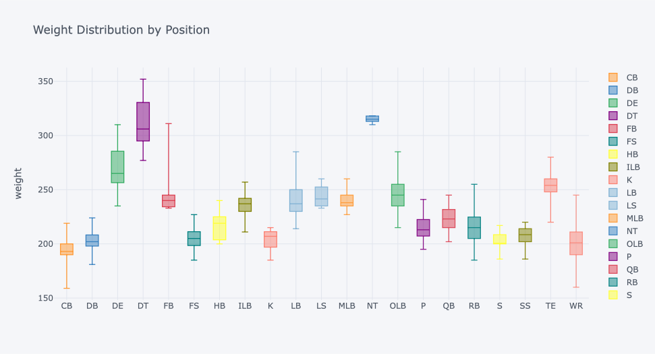
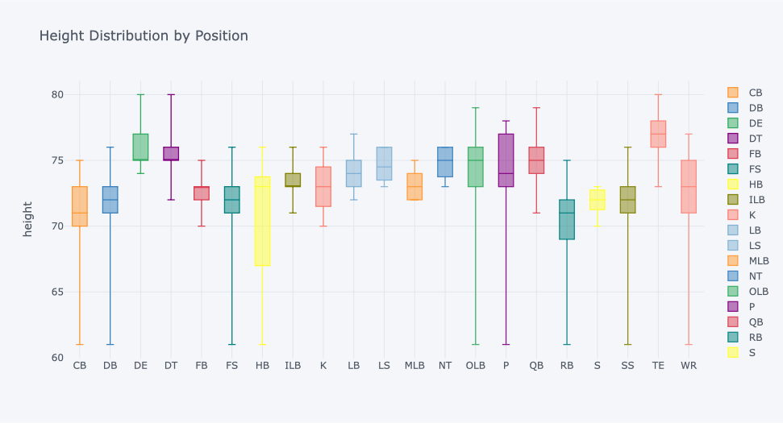
Exploratory Data Analysis
Note: Library plotly

Slide 8
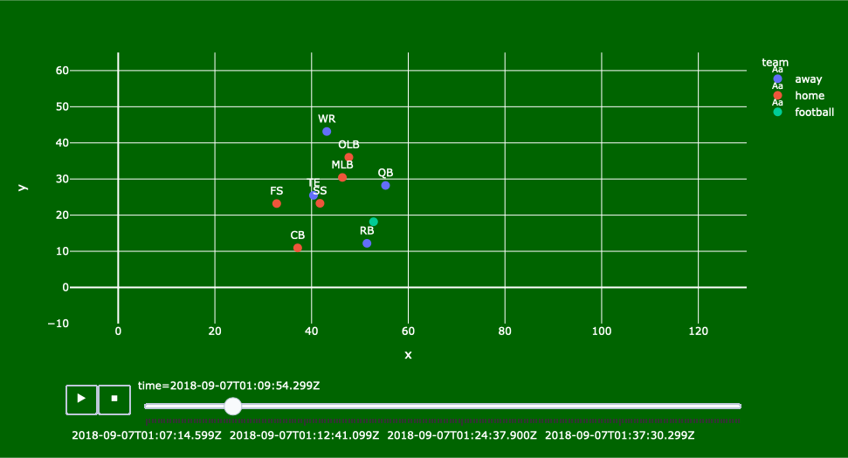
Exploratory Data Analysis

Slide 9
Classification
For classifying “pass-result” into Complete pass (C) , Incomplete pass (I) , Quarterback sack (S) , Intercepted pass (IN), we have used following classification models:
Logistic Regression
Gradient Boosting Regressor
Random Forest
Bagging

Slide 10
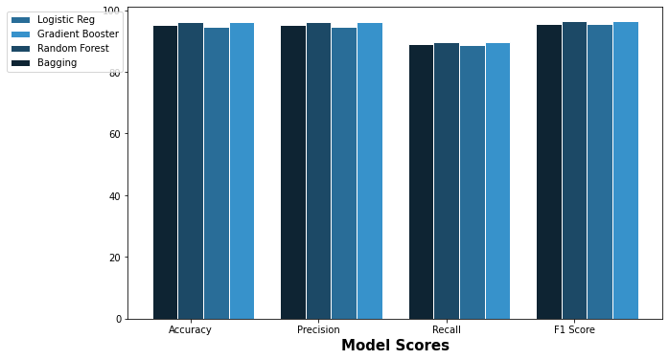
Comparison of Performance Measures

Slide 11
Comparison of Classification models
Models | F1-score
Logistic Regression | 89.0256
Gradient Boosting Regressor (GBR) | 95.5083
Random Forest | 95.3030
Bagging | 95.2015
The best model classifier we is Gradient Boosting Regressor
F1-score is the harmonic mean of precision and recall, so it provides the better score for any other performance measures.

Slide 12
Gradient Boosting Regressor
Confusion matrix
 | C | I | IN | S
C | 4456 | 82 | 2 | 0
I | 8 | 2486 | 5 | 1
IN | 1 | 164 | 4 | 0
S | 0 | 13 | 0 | 472
C - Complete pass
I - Incomplete pass
IN - Intercepted pass
S - Quarterback Sack

Slide 13
Result
Classification report
 | Precision | Recall | F1-score | Support
C | 1.00 | 0.98 | 0.99 | 4540
I | 0.91 | 0.99 | 0.95 | 2500
IN | 0.36 | 0.02 | 0.04 | 169
S | 1.00 | 0.97 | 0.99 | 485
Accuracy |  |  | 0.96 | 7694
Macro avg | 0.82 | 0.74 | 0.74 | 7694
Weighted avg | 0.95 | 0.96 | 0.96 | 7694

Slide 14
Conclusion ??
We found that among the models that outperformed the others, the Gradient Boosting Regression model indicated the highest F-1 score for the dataset.
Gradient Boosting Regressor (GBR) predicted with an F1 score of 95.5083
It is evident from this project that indeed classification models can be used to determine whether or not a play will result in a yard line gain during that particular play. General managers can then make decisions based on these insights to better improve gameplay strategies.

Slide 15
References
https://operations.nfl.com/the-game/big-data-bowl/
https://nextgenstats.nfl.com
nfl-big-data-bowl-2021

